Slide 1
MULTI-CUT REBAR(11)
Advisor : Prof. K.C.Chang
Presenters : You-Ran Nai
Notes:
試試看暫停一下

Slide 2
Outline
1
2
3
4
5
Load Pattern
IDA vs Pushover
Nonlinear Hinge
GUI Progress
Roadmap
Notes:
Pushover mode load pattern
Time history inertia force vs mode shape
Ida vs pushover
Pushover nonlinear hinge
GUI progress
Roadmap

Slide 3
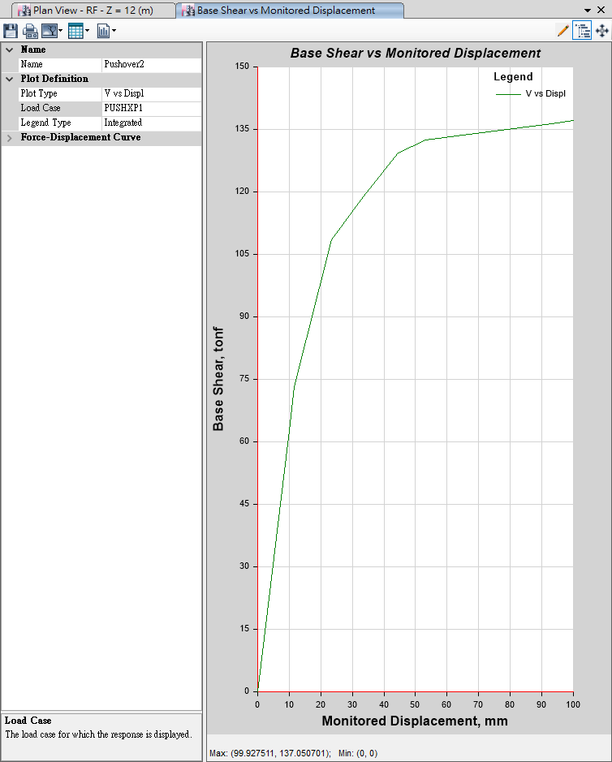
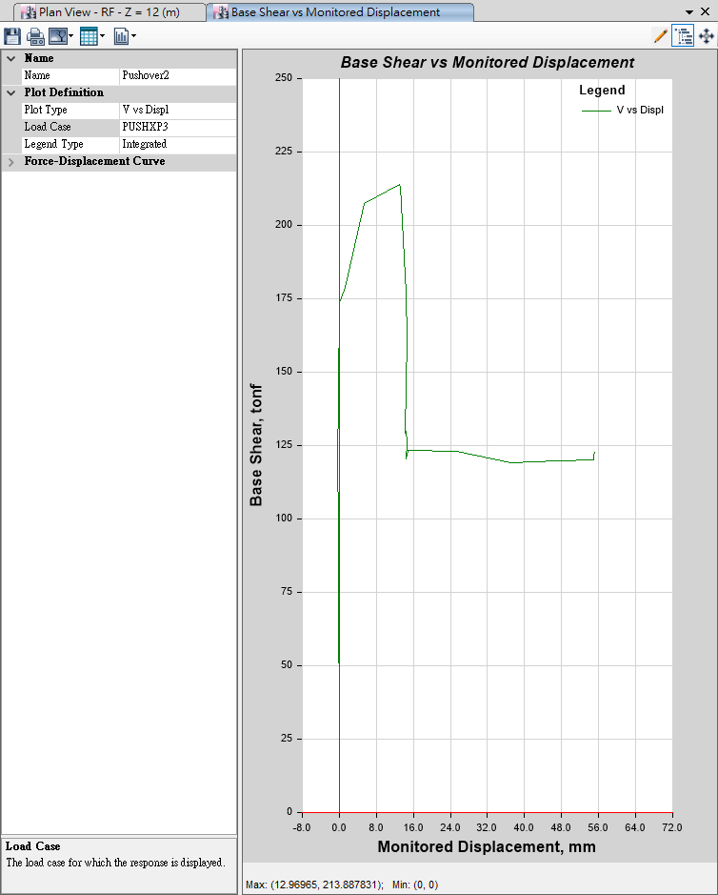
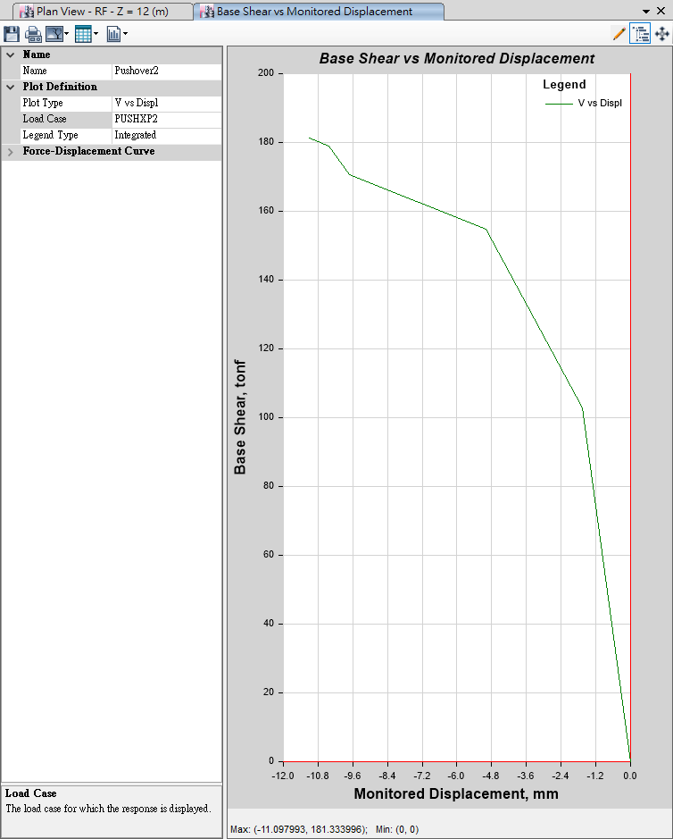
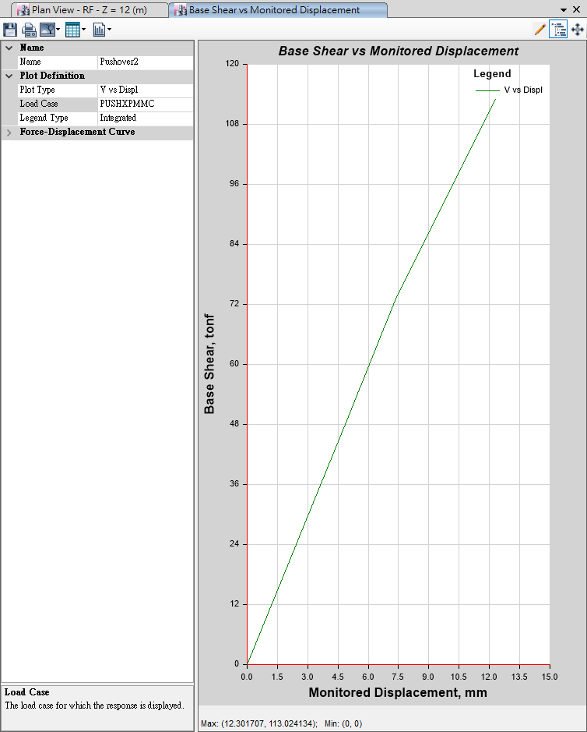
Pushover
Mode 1
Mode 3
100mm
10mm
User Defined
Mode 2
MMC
10mm
10mm

Slide 4
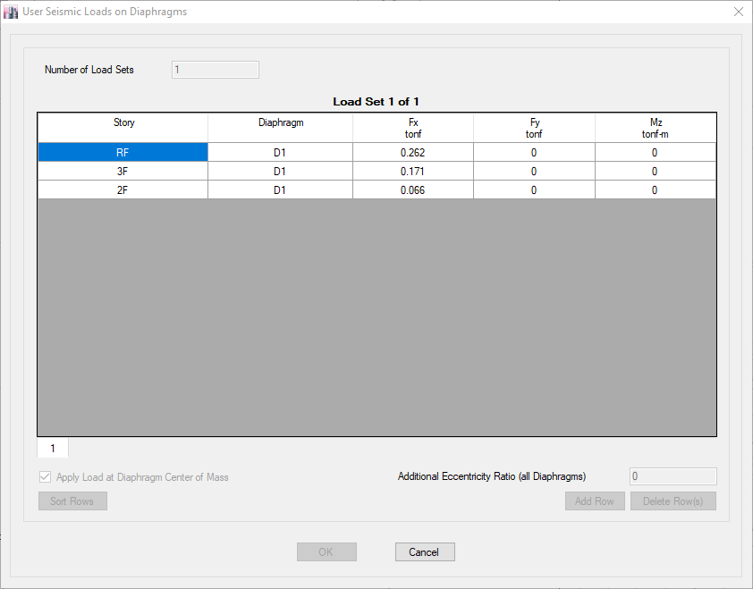
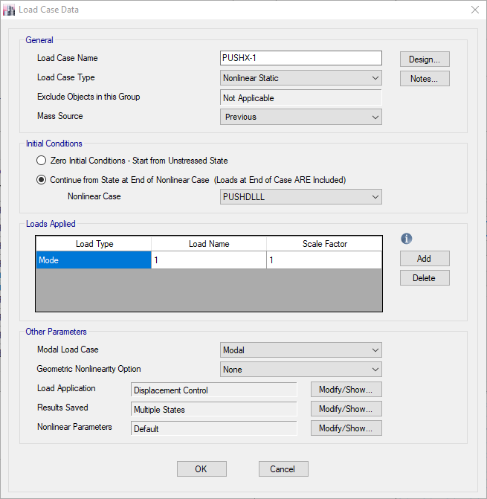

Auto Generate Mode
User Defined Mode

Slide 5
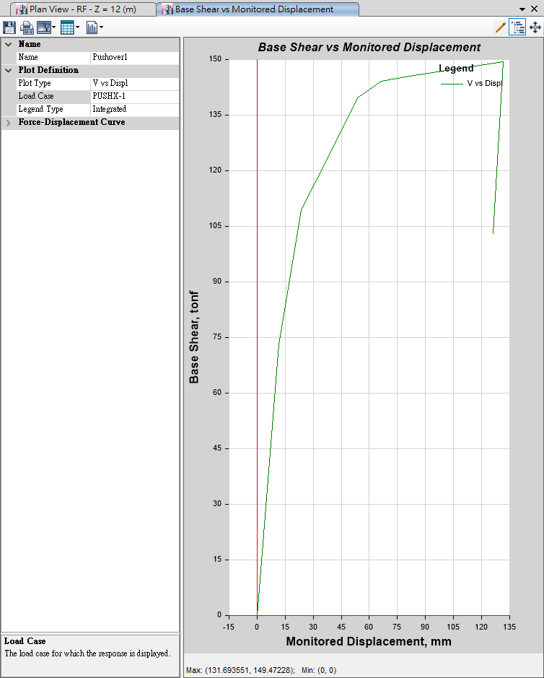
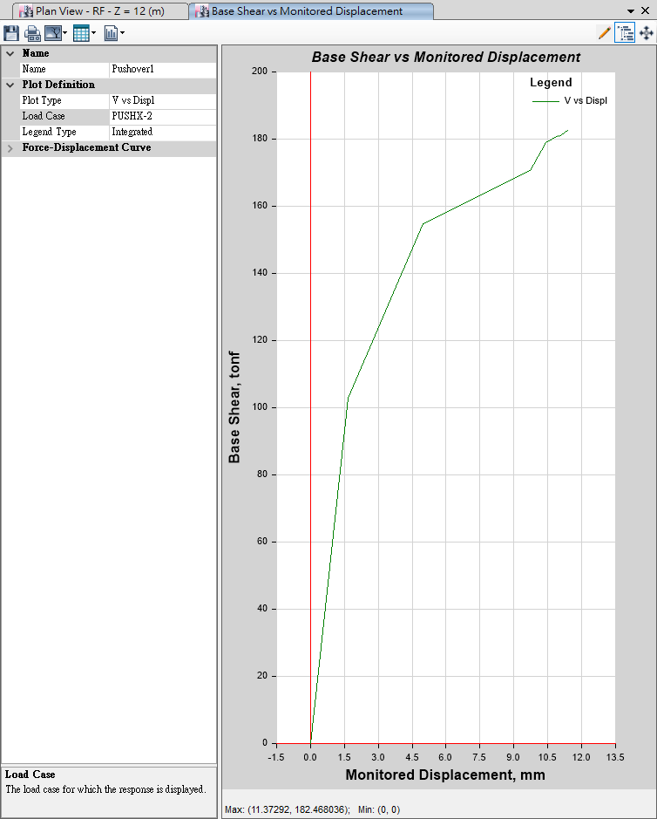
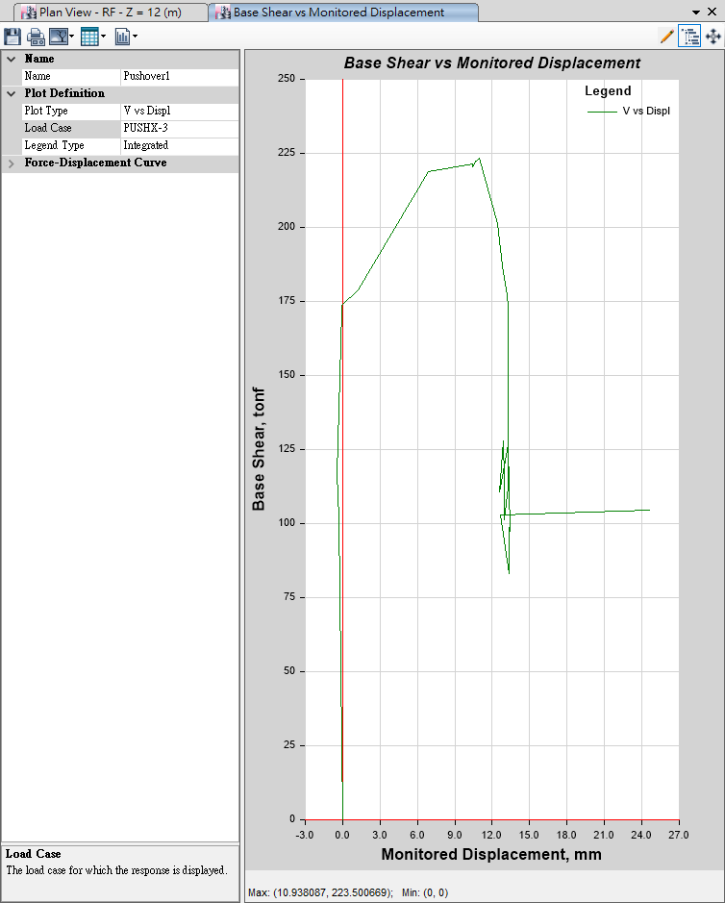
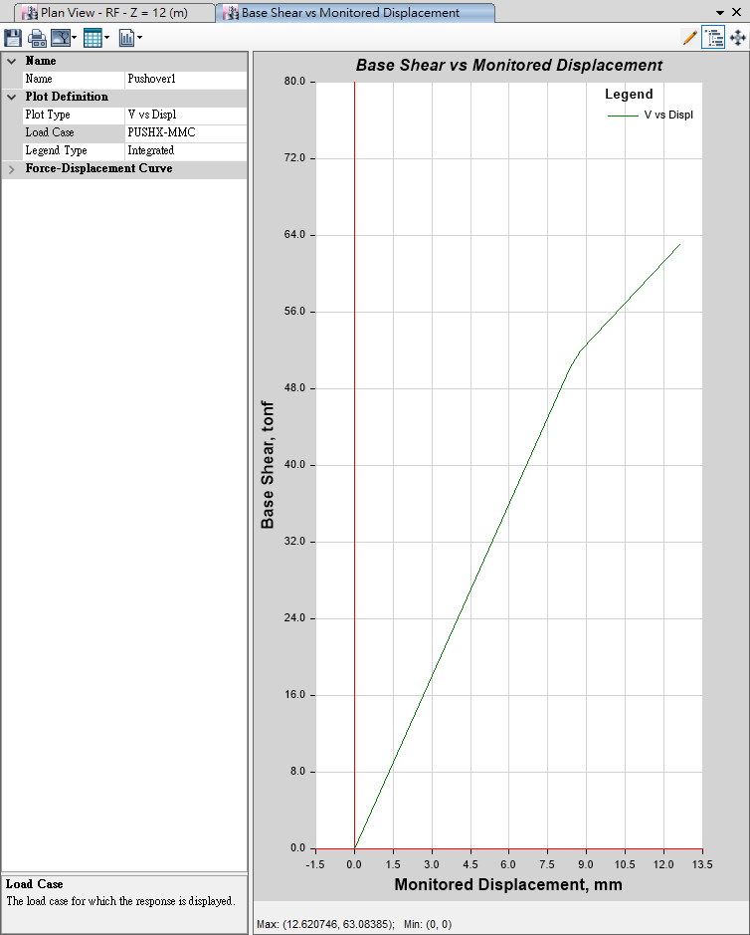
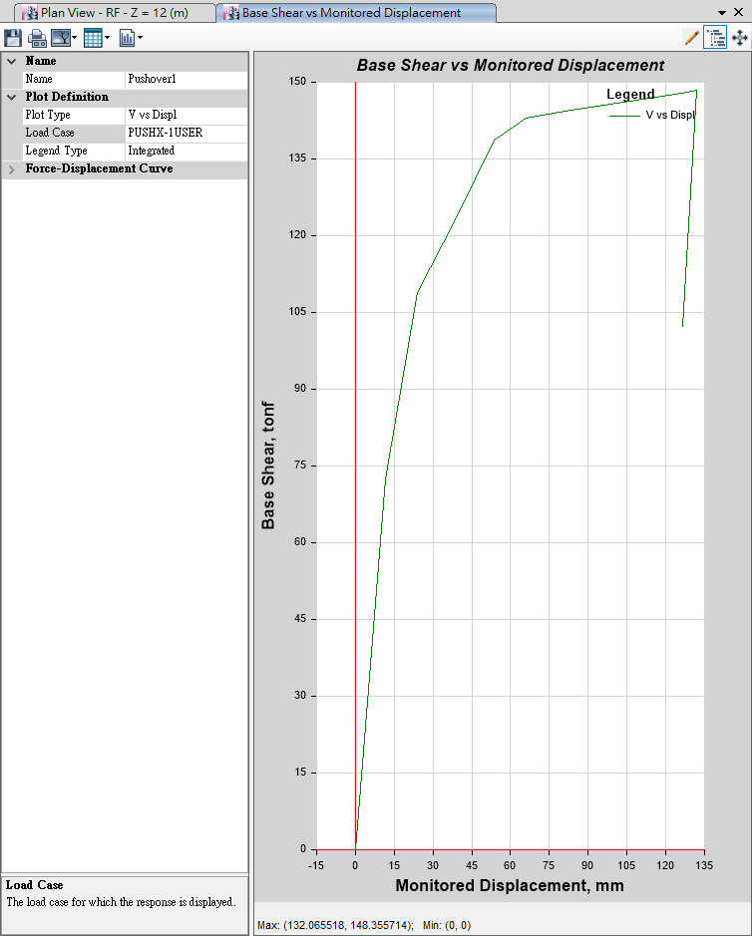
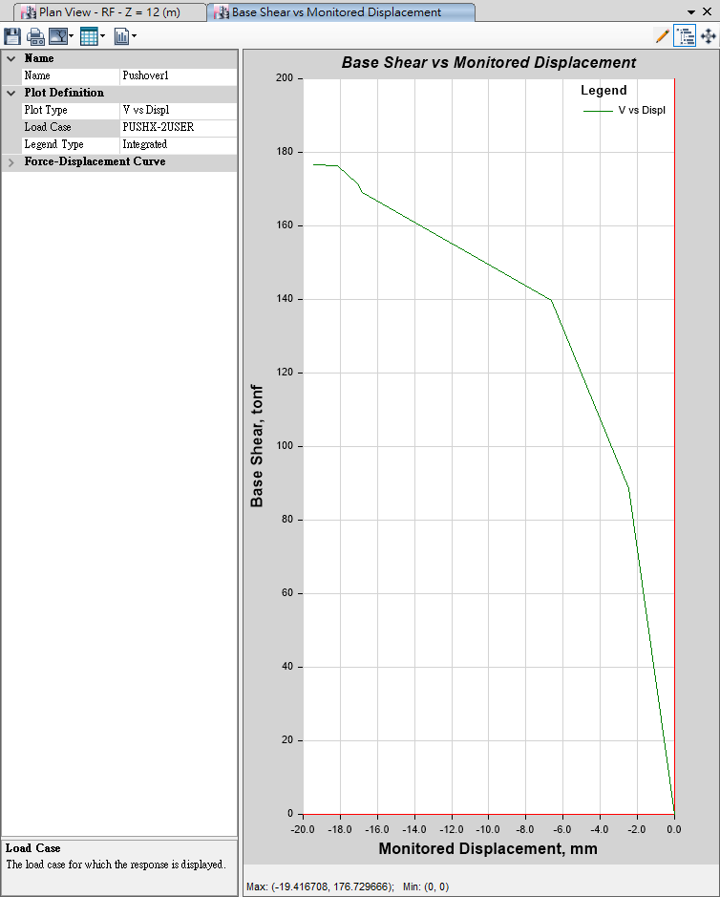
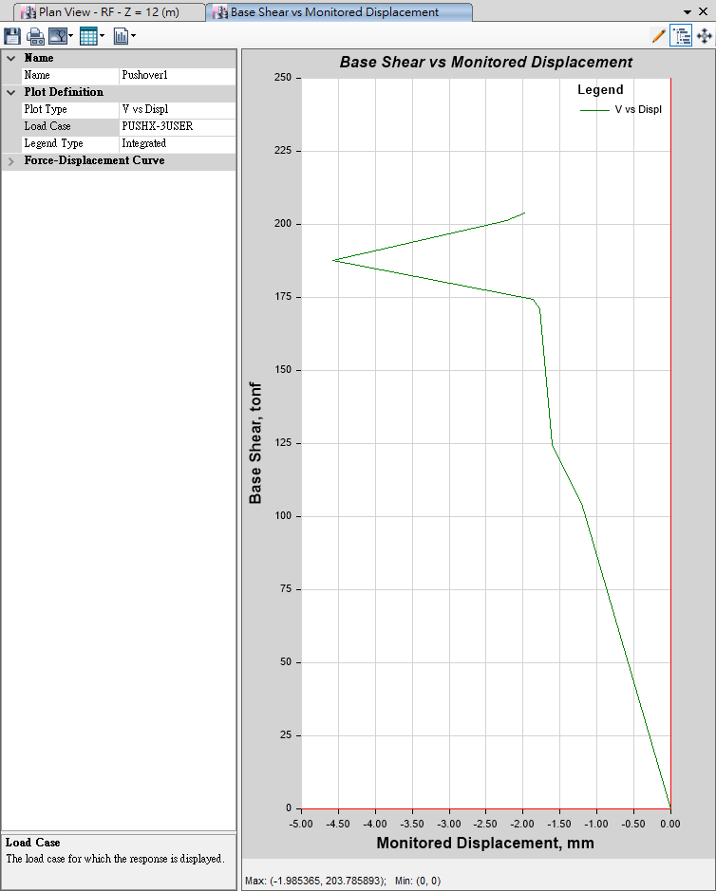

Auto
Generate
Mode
Mode 1
135mm
Mode 2
13mm
Mode 3
27mm
-MMC-
13mm
User Defined
User
Defined
Mode
Mode 1
135mm
Mode 2
20mm
Mode 3
5mm
-MMC-
150mm

Slide 6
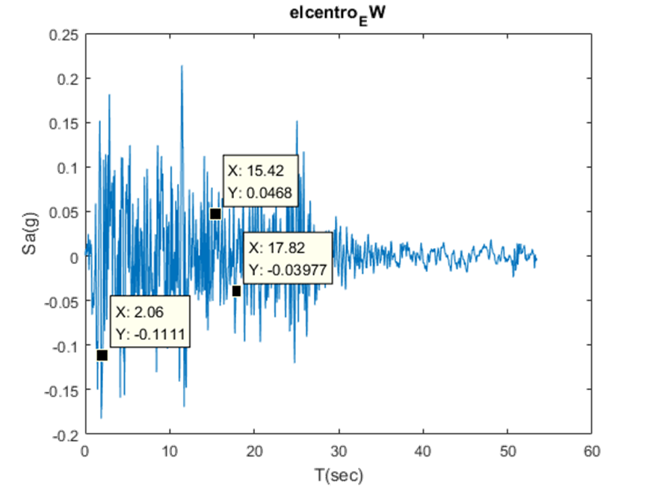
Inertia Force

Slide 7
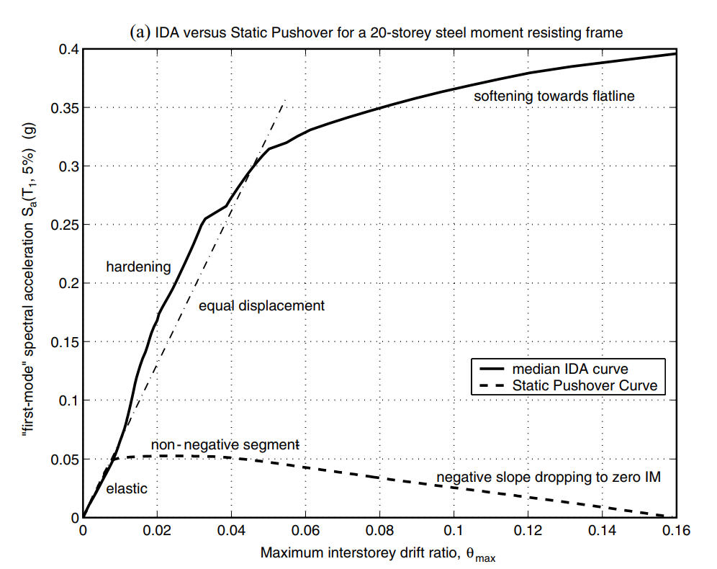
NON-LINEAR SPO
ELASTIC
➔
MATCH
NON-NEGATIVE
➔
EQUAL DISPLACEMENT
NEGATIVE
➔
SOFTENING

Slide 8
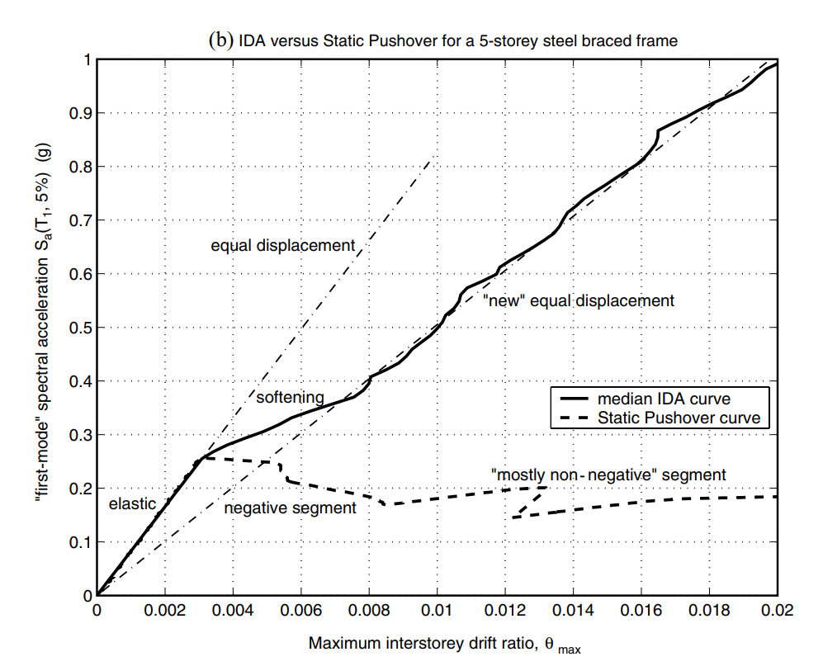
NON-LINEAR SPO
NEGATIVE => NON-NEGATIVE
NEW
EQUAL DISPLACEMENT
➔

Slide 9
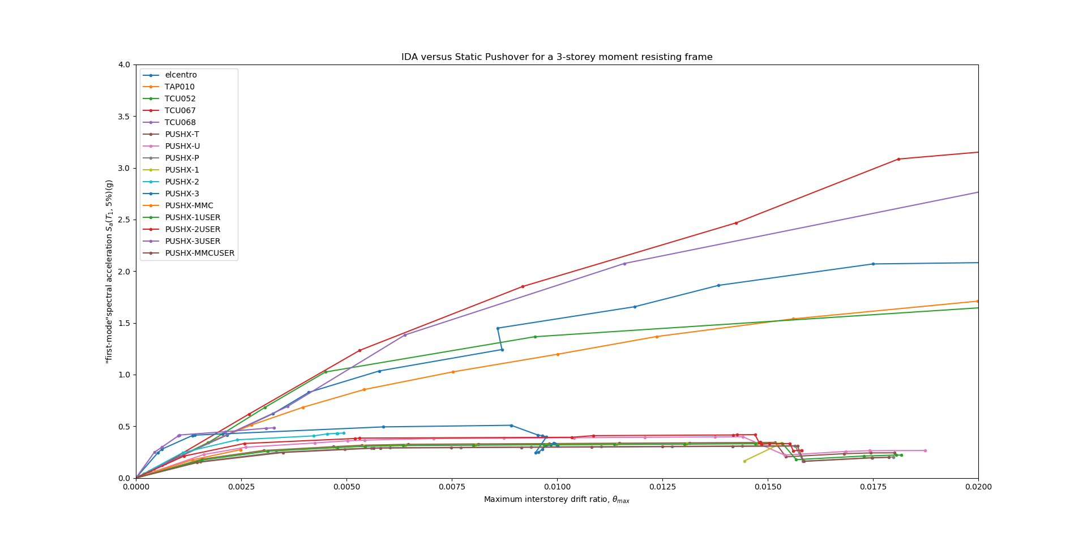

Slide 10
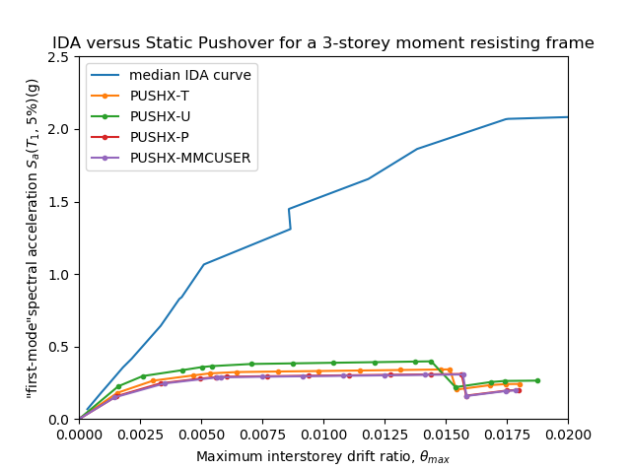
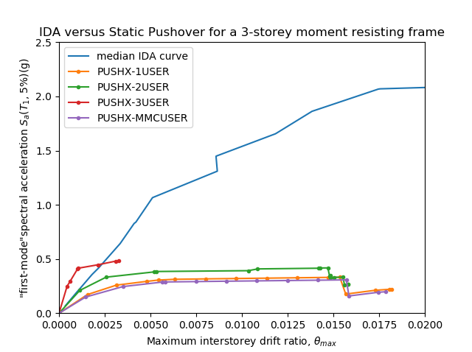
IDA vs Pushover

Slide 11
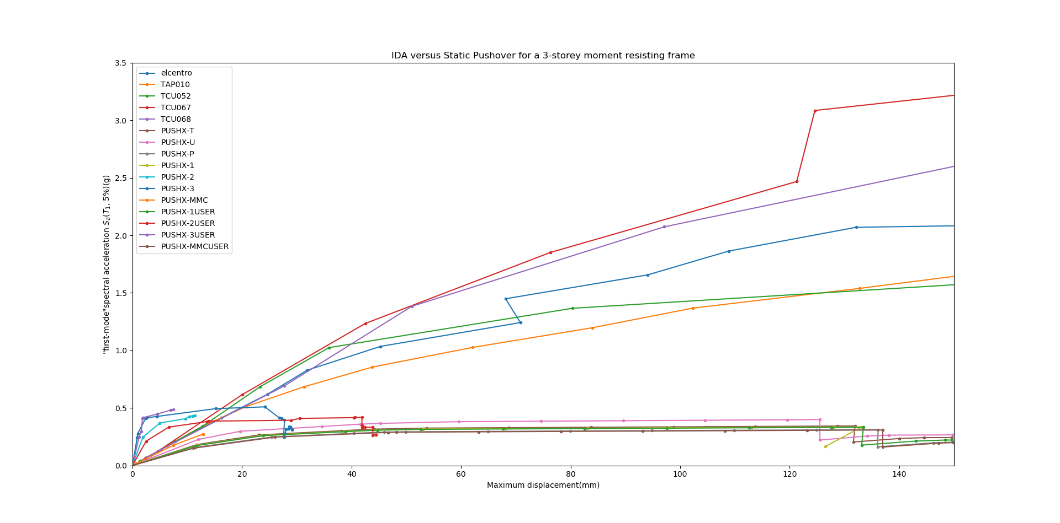
Displacement

Slide 12
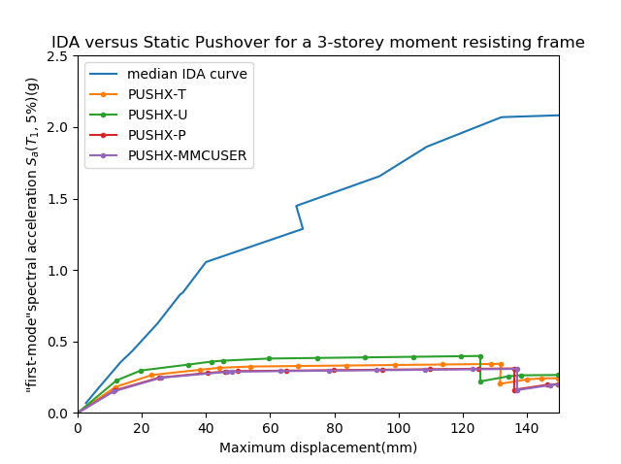
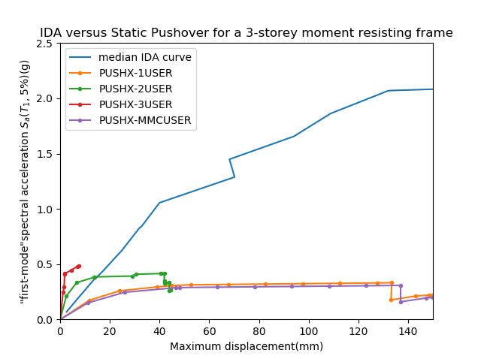
IDA vs Pushover
Displacement
Displacement

Slide 13
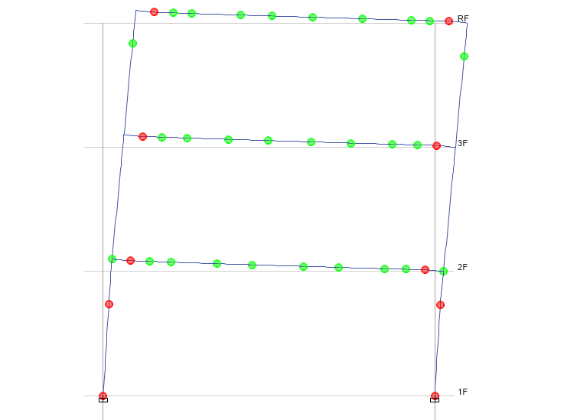
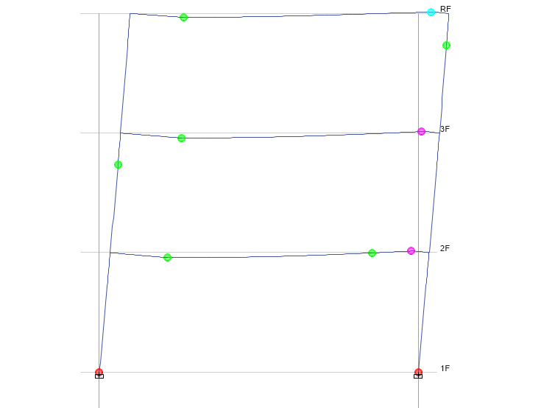
Beam Design
Time History
Pushover
No Middle Hinge

Slide 14
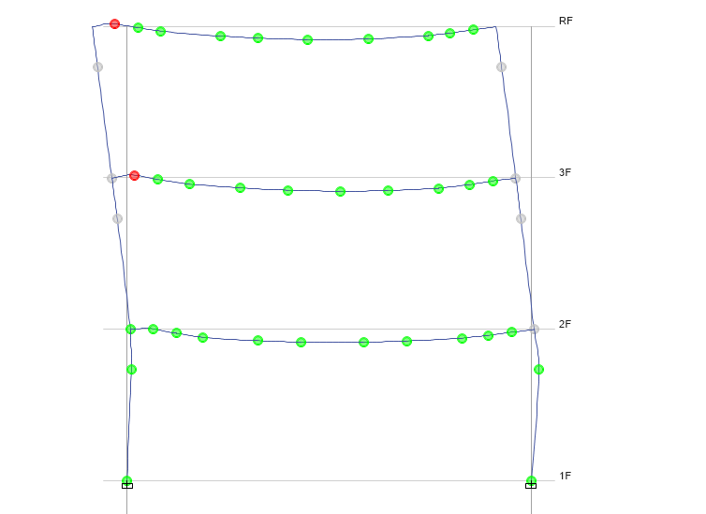
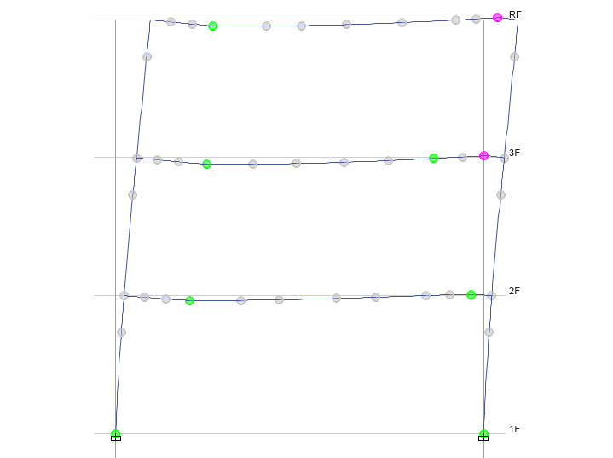
Strong Column Weak Beam
Time History
Pushover
No Middle Hinge

Slide 15
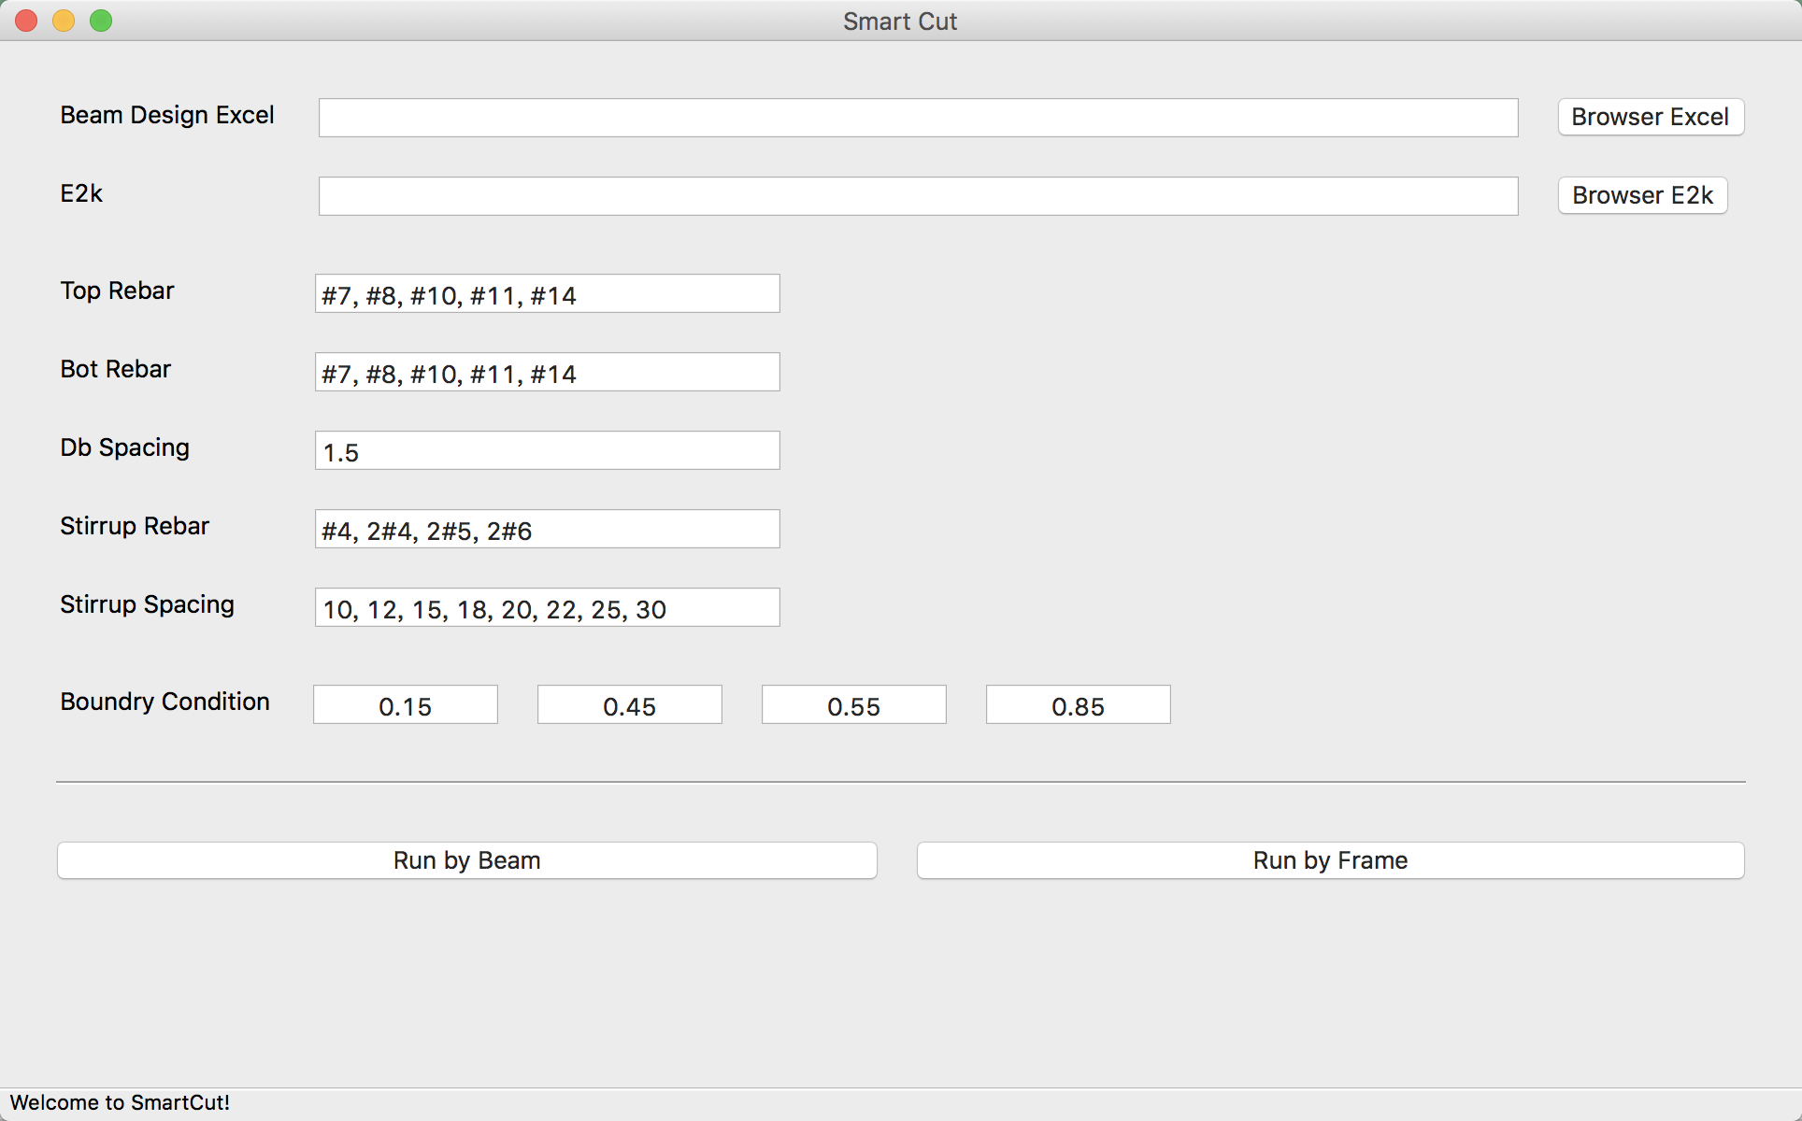
LinearCut
GUI

Slide 16
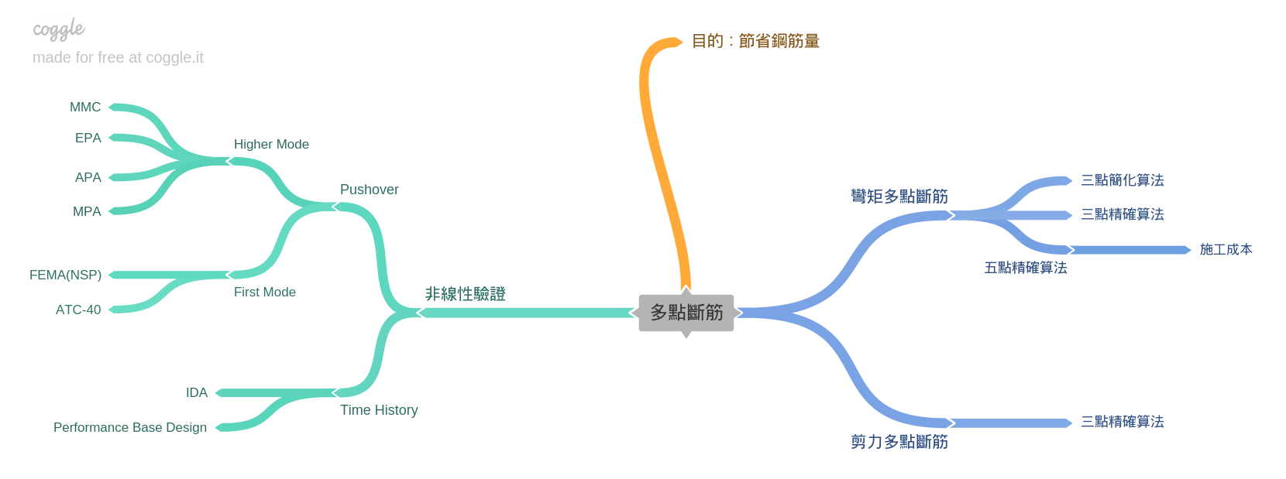
Roadmap
GUI
Nonlinear Hinge

